Slide 1
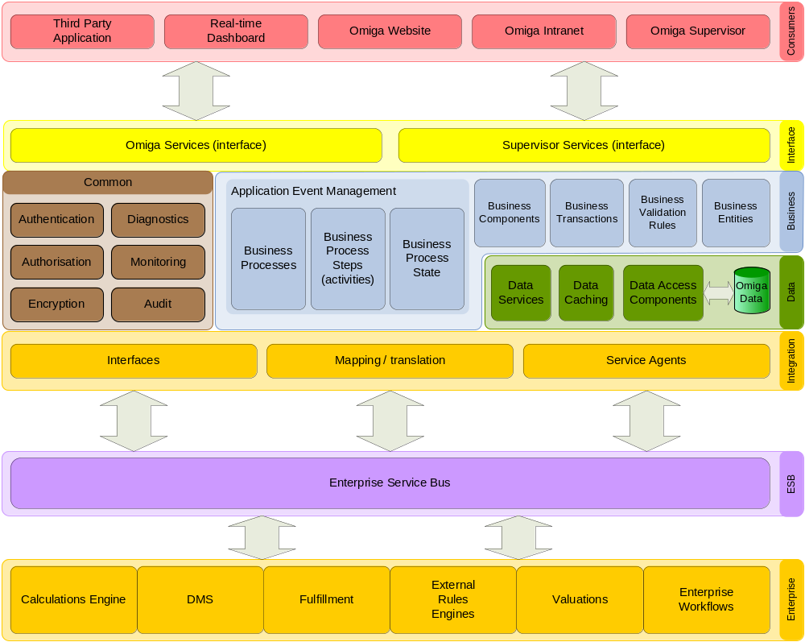
Vision – End state architecture
Service
Oriented
Architecture
(SOA)
Reuse existing:
  Vertex
  services
  Vertex
  components
Shared:
  Vertex
  infrastructure
  Vertex
  resource
  Vertex
  knowledge
  Vertex
  tools
Notes:
Service Oriented Architecture (SOA)
Adherence to standards, principles and best practice in the market - standard tools and methods
Omiga as a collection of services and sub-systems implemented as loosely coupled components
Provides Omiga functionality via services
Consumes external and/or existing enterprise services
Omiga services to be consumed by Omiga UIs, external systems and 3rd party UIs
Emphasis on reuse of existing components available with the group

